Slide 1
Azimuth range heatmap
Polar coordinates
15.5.2023

Slide 2
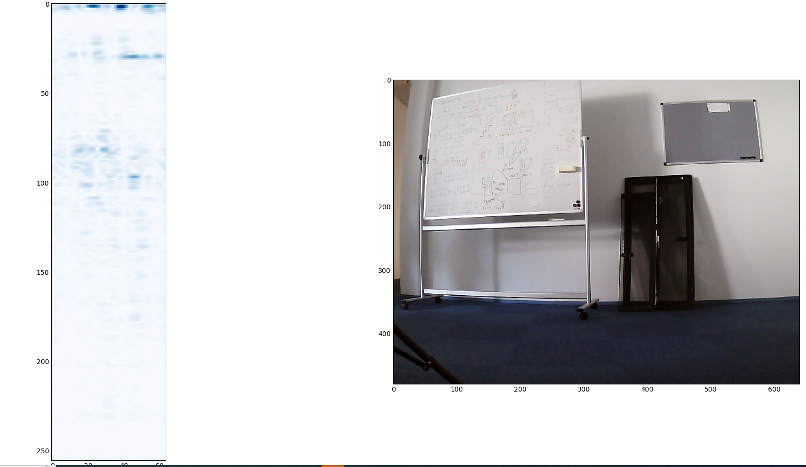
r=123cm azim=-32deg
Camera pixel of center of pipe: not on screen (~ -30)
480x640

Slide 3
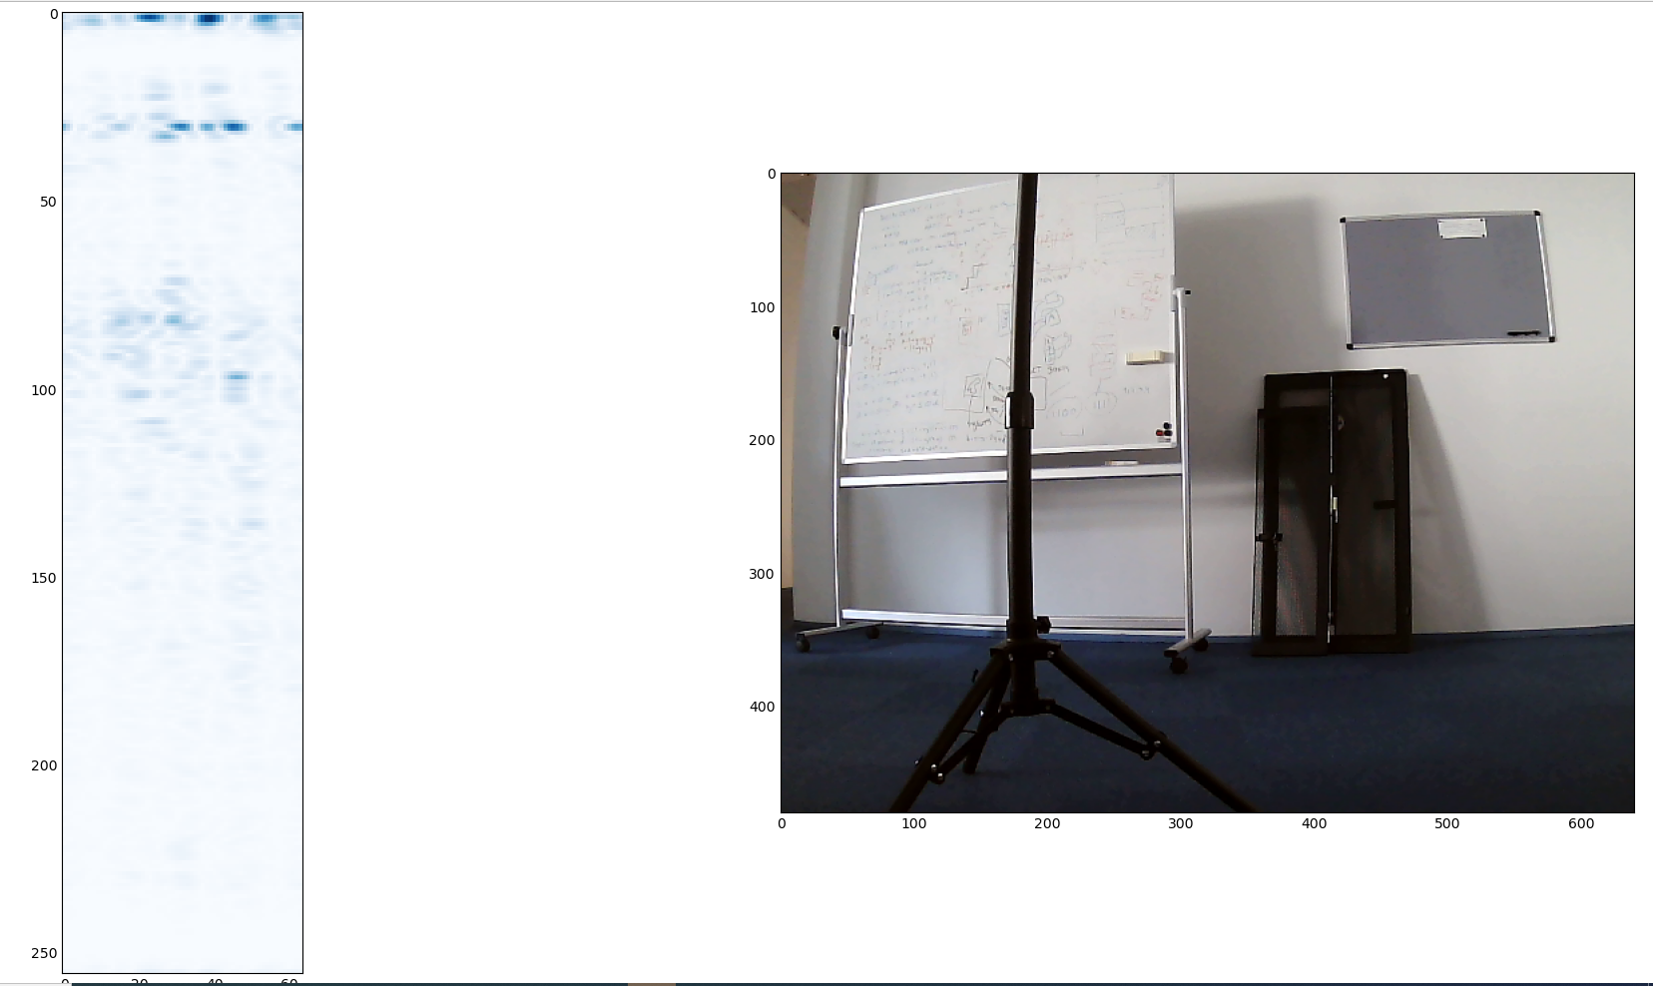
123cm -14deg
Camera pixel of center of pipe:
~180

Slide 4
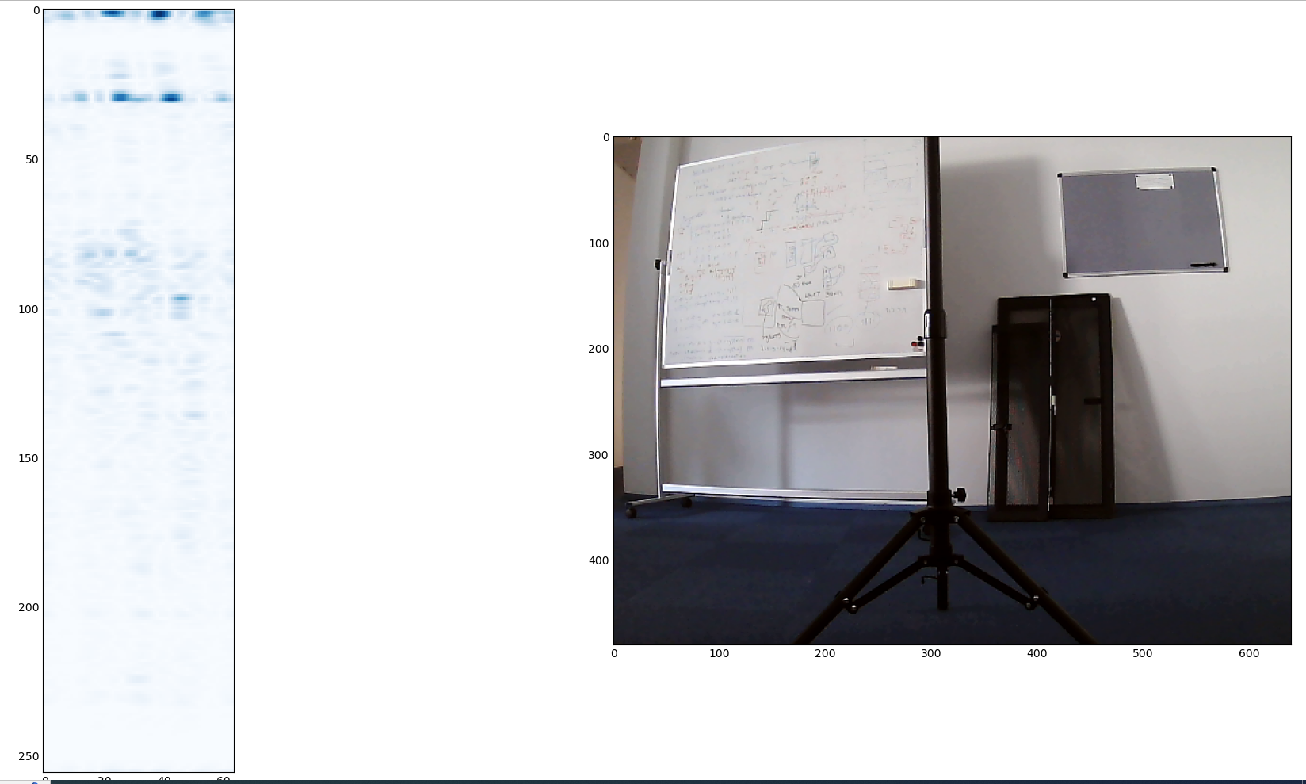
123cm 0deg
Camera pixel of center of pipe:
~320

Slide 5
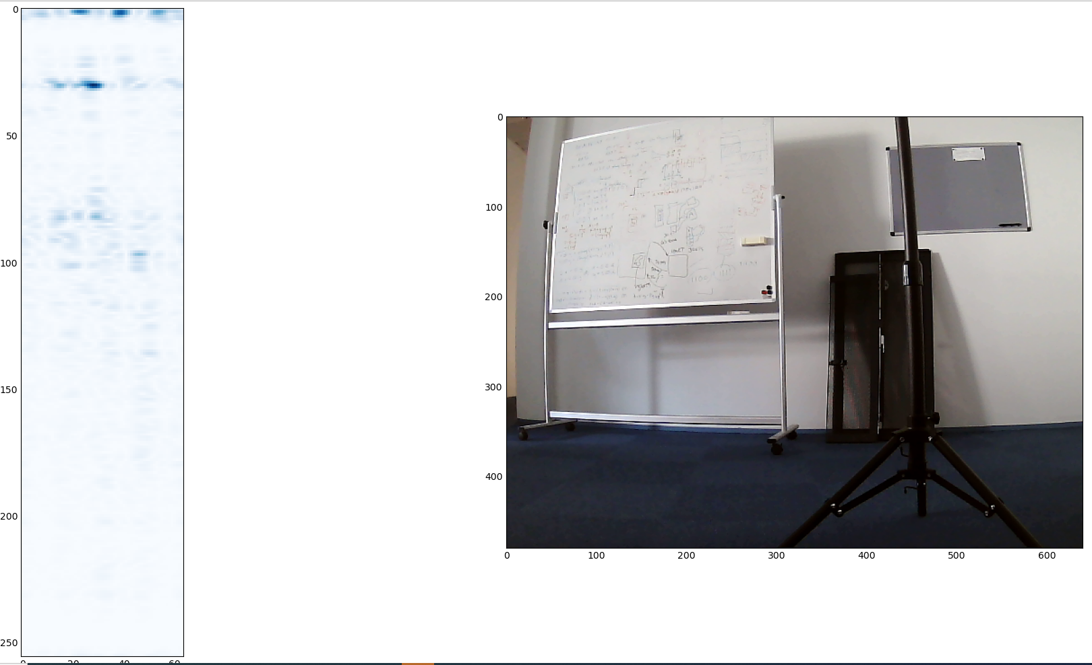
123cm 13deg
Camera pixel of center of pipe:
~450

Slide 6
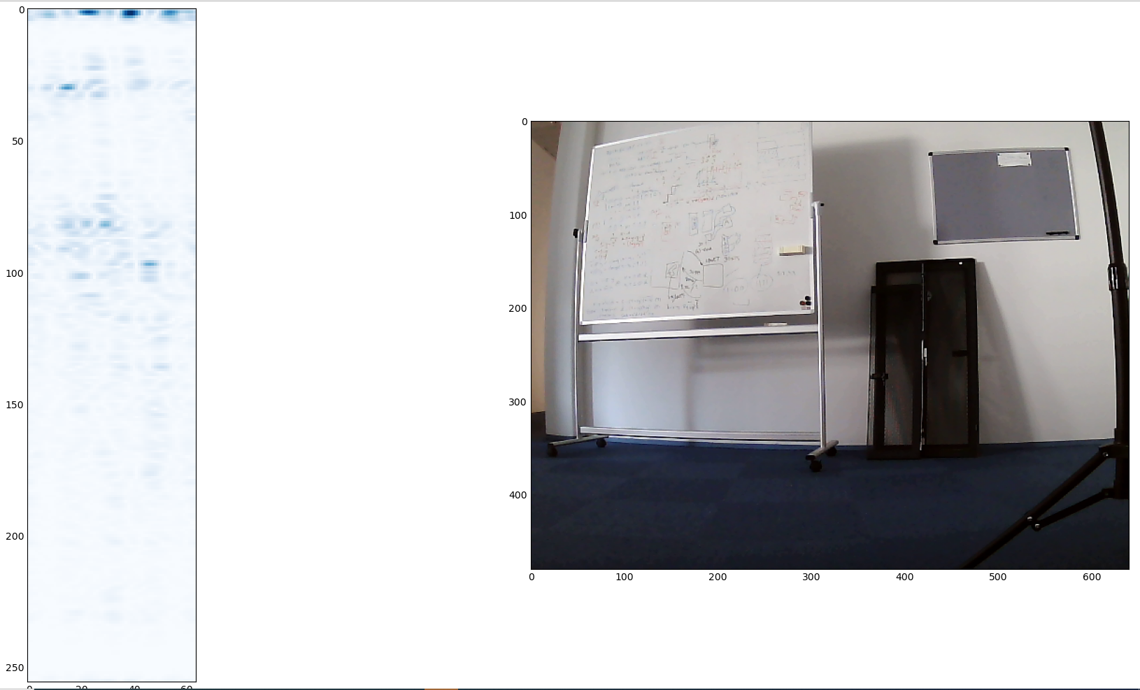
123cm 23deg
Camera pixel of center of pipe:
~630

Slide 7
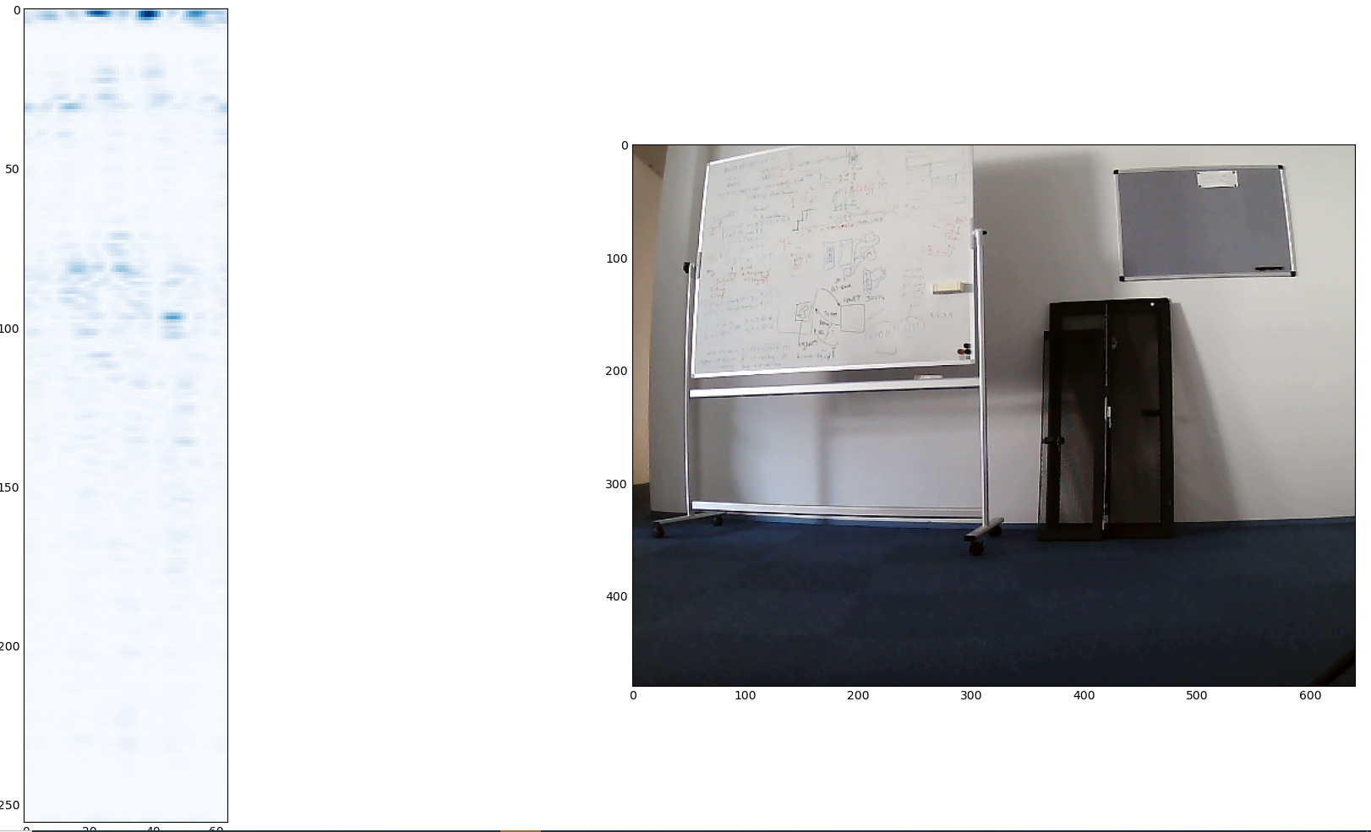
123cm 45deg
Camera pixel of center of pipe:
Out of screen. Approx 740

Slide 8
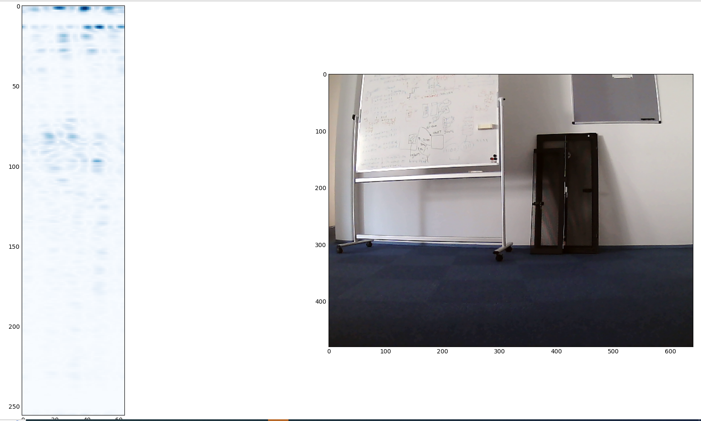
50cm -42deg
Camera pixel of center of pipe:
Out of screen. Approx -150

Slide 9
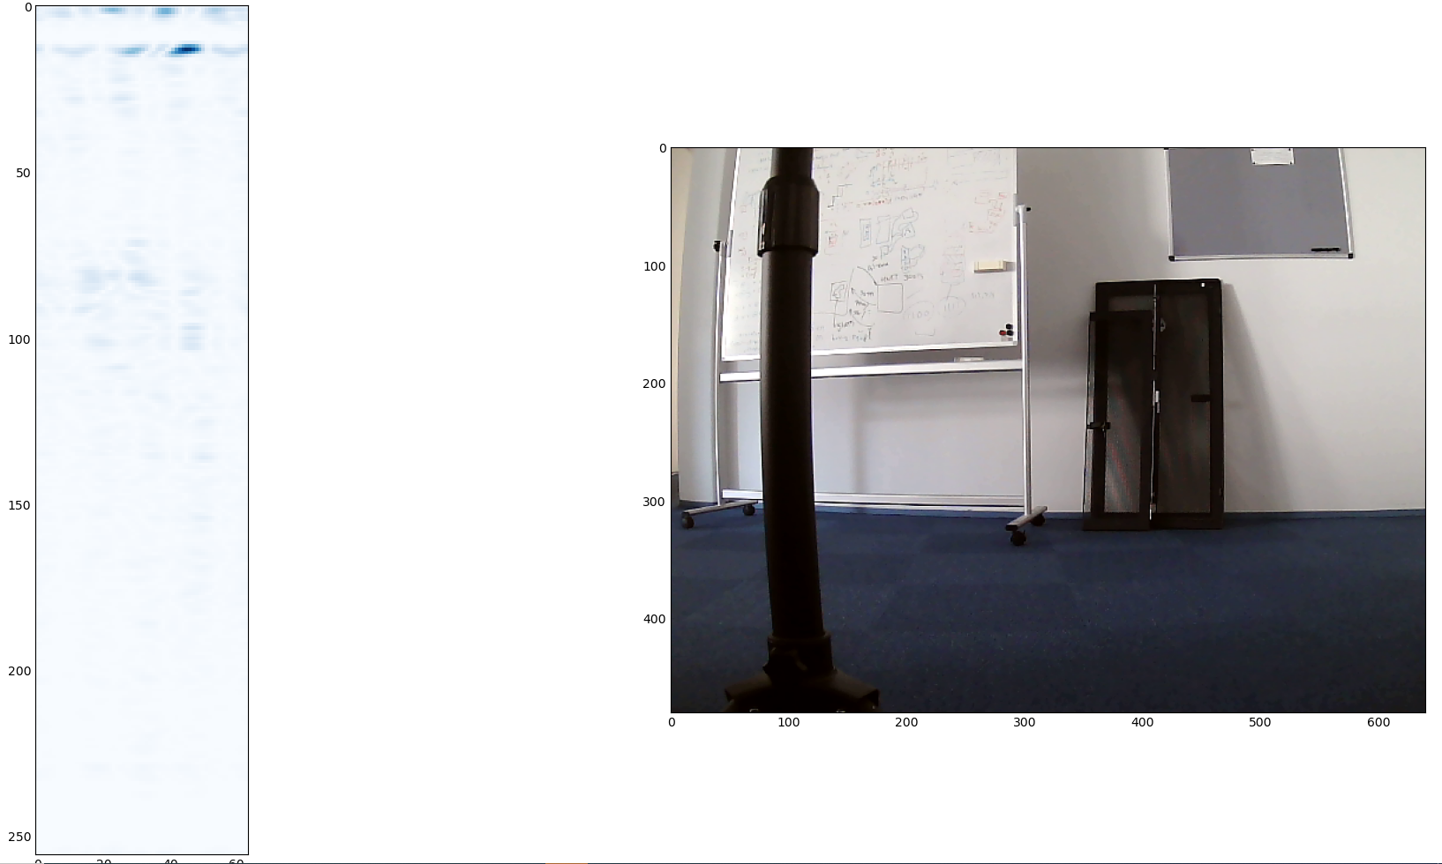
50cm -20deg
Camera pixel of center of pipe:
~100

Slide 10
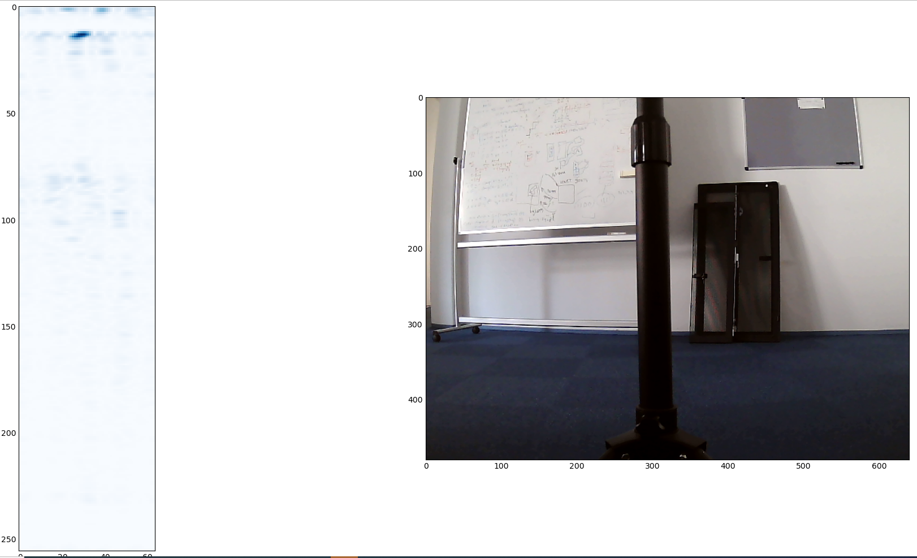
50cm 0deg
Camera pixel of center of pipe:
310

Slide 11
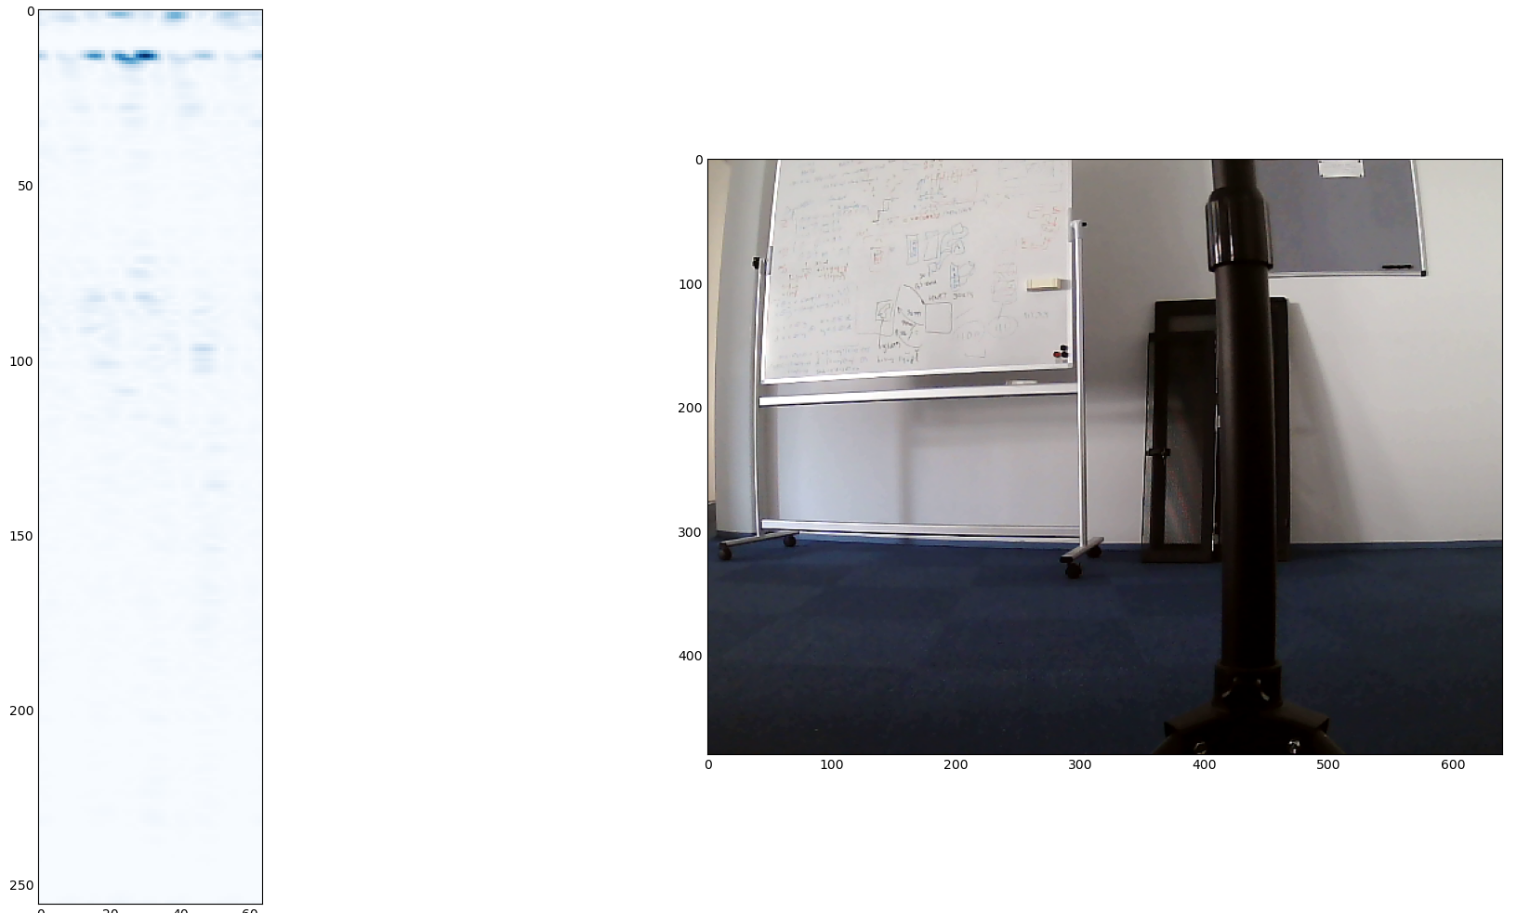
50cm 16deg
Camera pixel of center of pipe:
~430

Slide 12
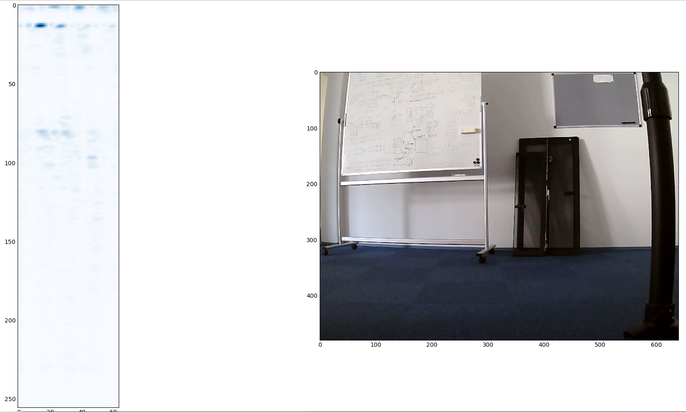
50cm 35deg
Camera pixel of center of pipe:
~610

Slide 13
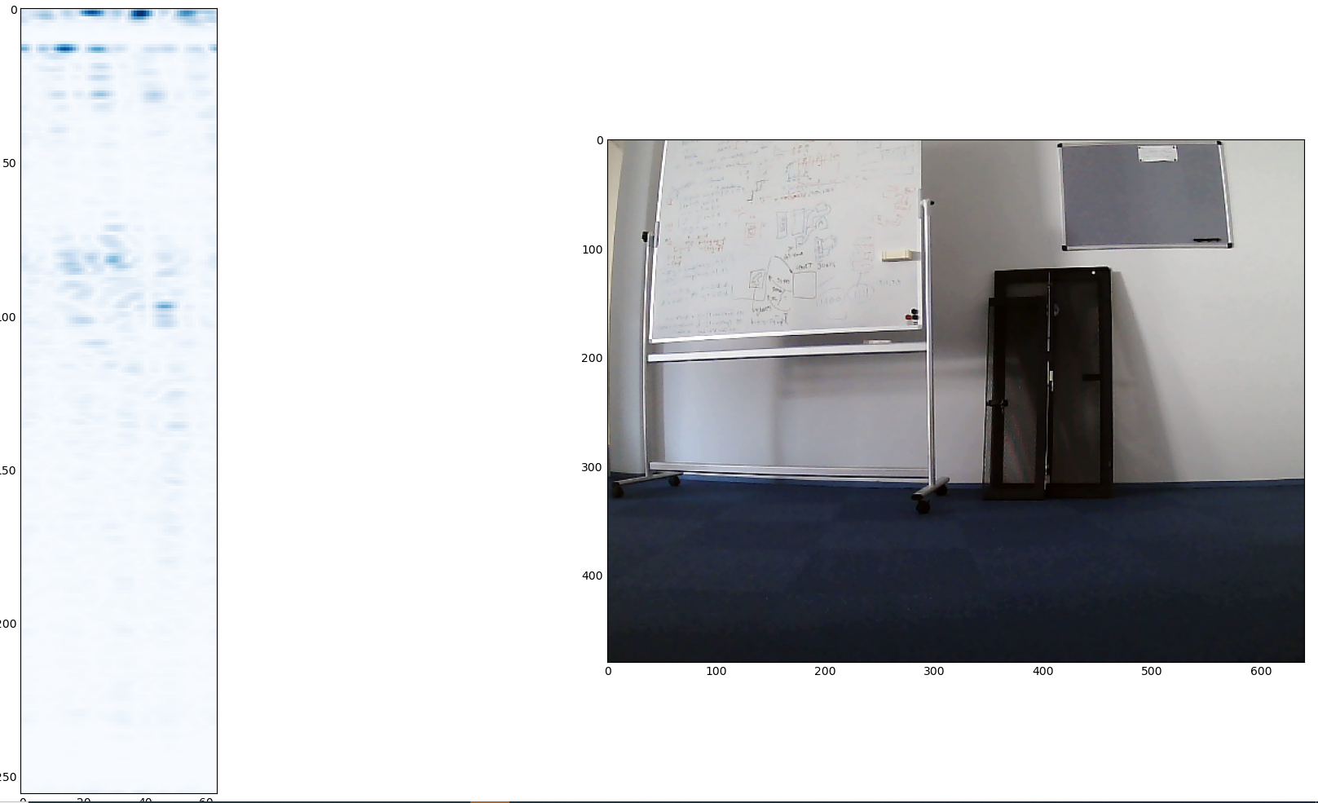
50cm 44deg
The correct bin to range would therefore be 50cm/13= 3,8cm/bin
In javascript it is defined to be 4,36cm/bin (rangeStep)
<- This is bin 13
Camera pixel of center of pipe:
Out of screen. Approx 750

Slide 14
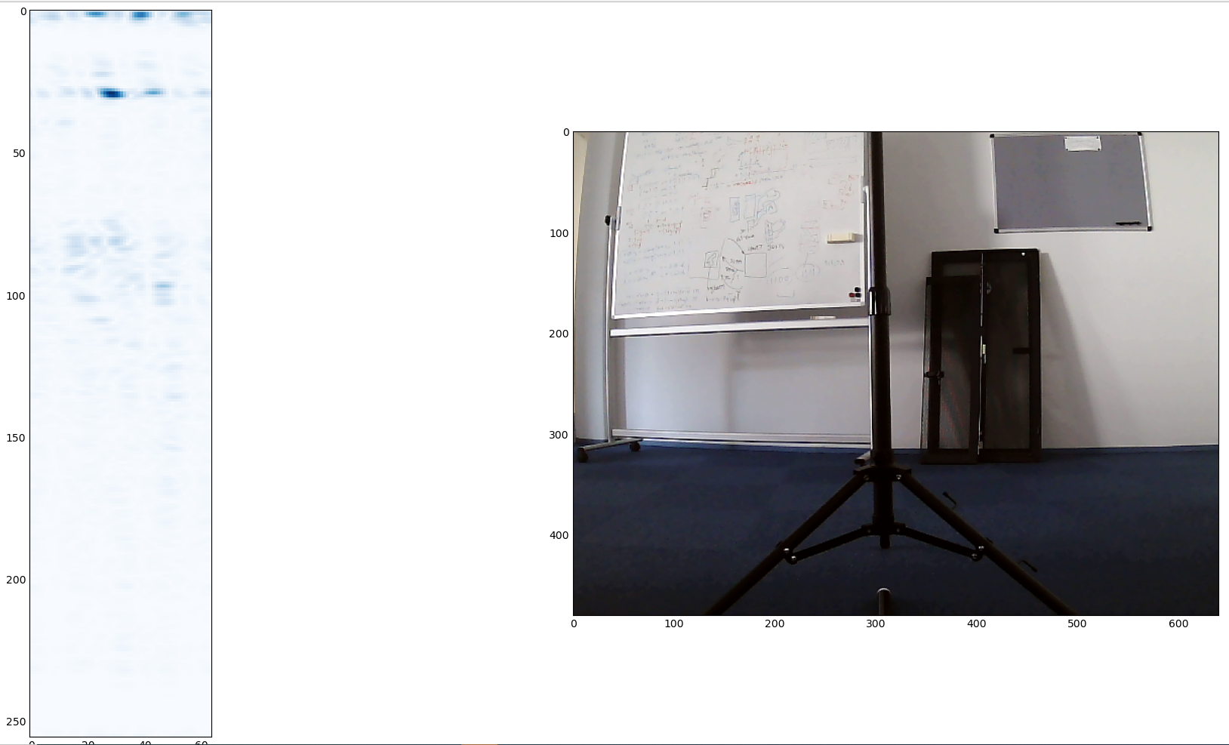
123cm 0deg
The correct bin to range would therefore be 123cm/30= 4,1 cm/bin
VS rangeStep = 4,36cm/bin
<- This is bin 30

Slide 15
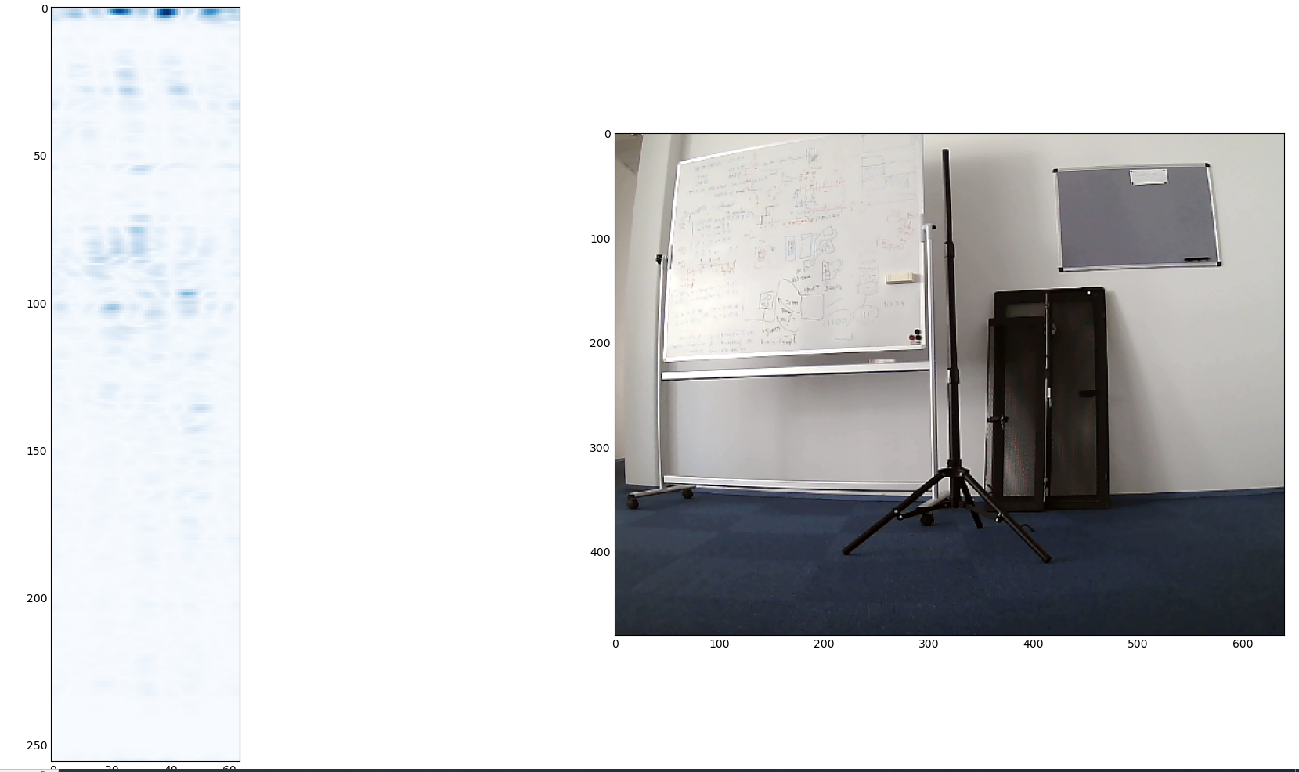
230cm 0deg
Forecast: Which result is the pole?
Expected BIN of the pole at 230cm with rangeStep = 4,36cm/bin
BIN = 53
<- This is bin 55

Slide 16
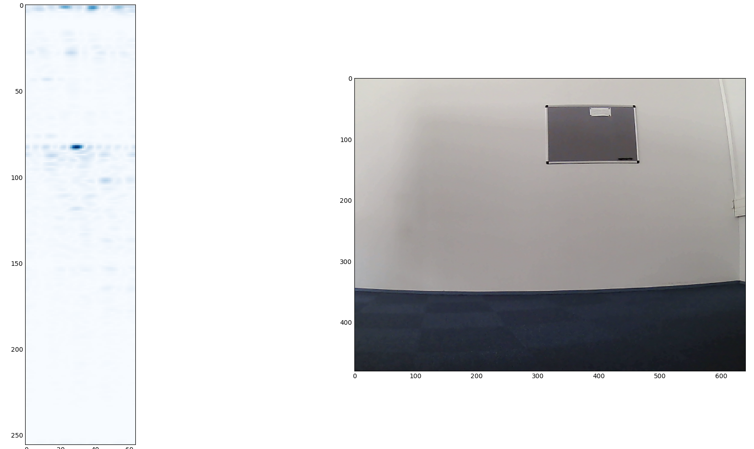

Clutter - straight at a wall
rangeStep = 4,36cm/bin
Radar: 362cm VS real life: 350cm
<- This is bin 83
Value 15400
<- This is bin 118
Value 2800
Radar: 514cm LEFT of the image
350cm Measurement
VS
362cm Radar sensing
Here is a corner the camera
doesnt see at a radial
distance of 440cm
VS
514cm with Radar sensing

Slide 17
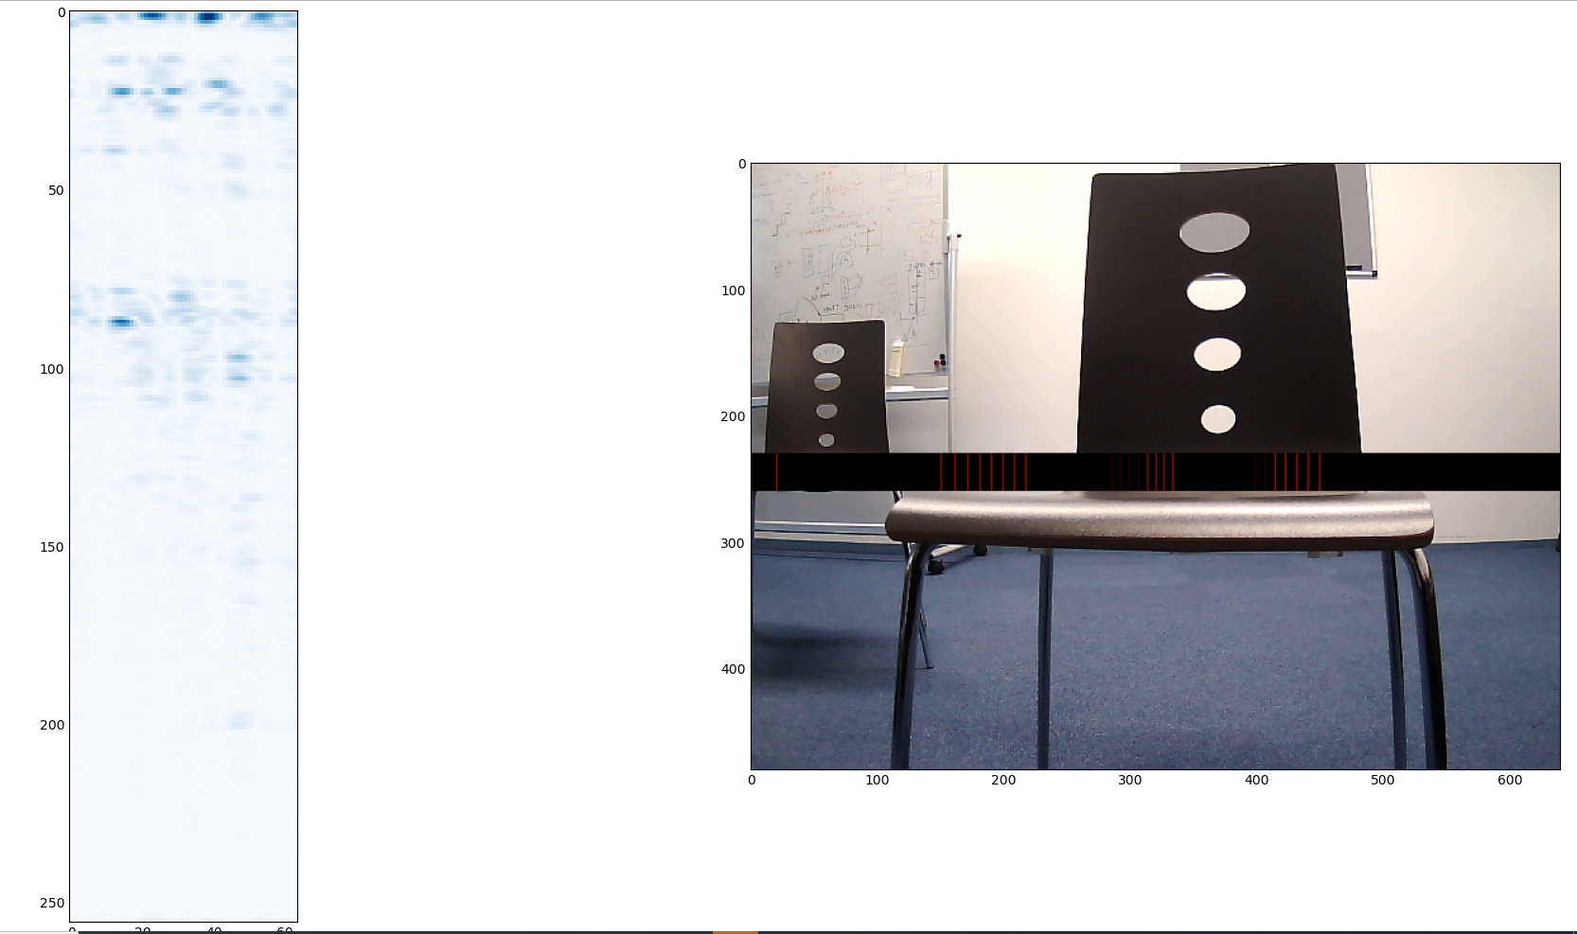
Calibration of scalefactor
xScaleFactor =
thetaScaleFactor = 1

Slide 18
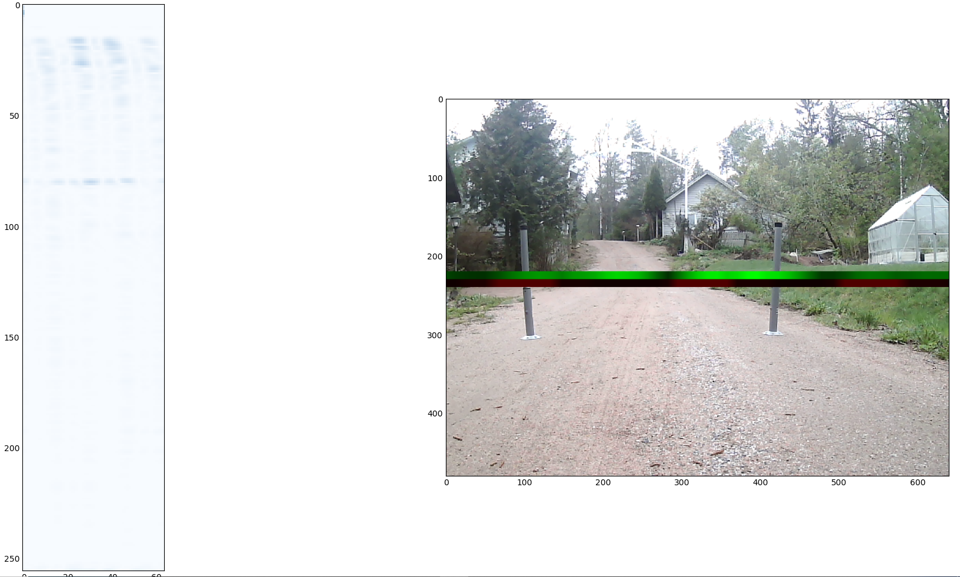
Outside

Slide 19
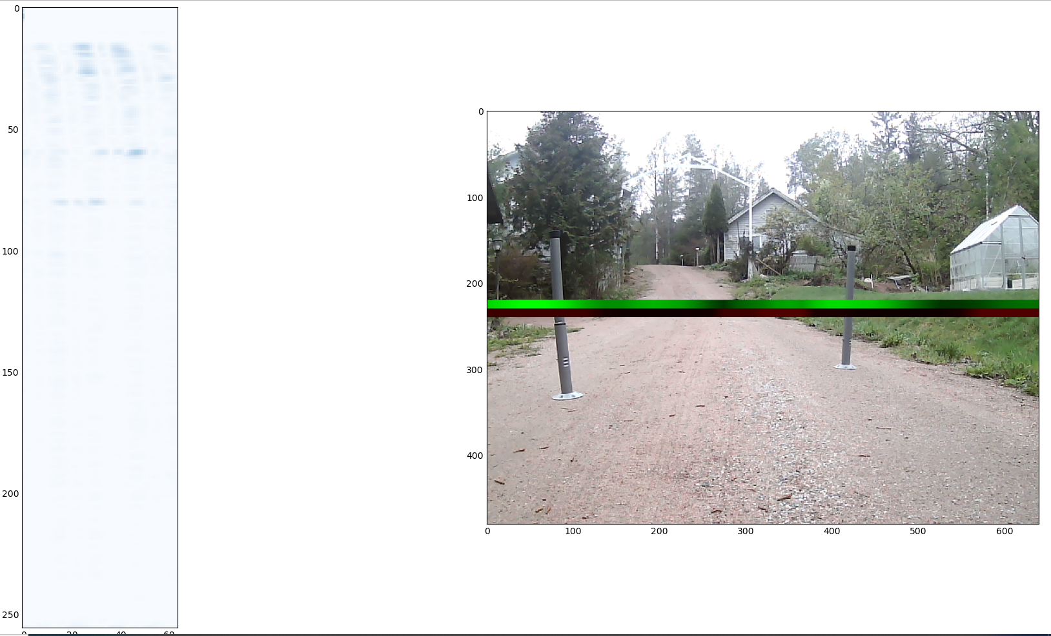
Outside
xScaleFactor = 300
thetaScaleFactor = 1.6

Slide 20
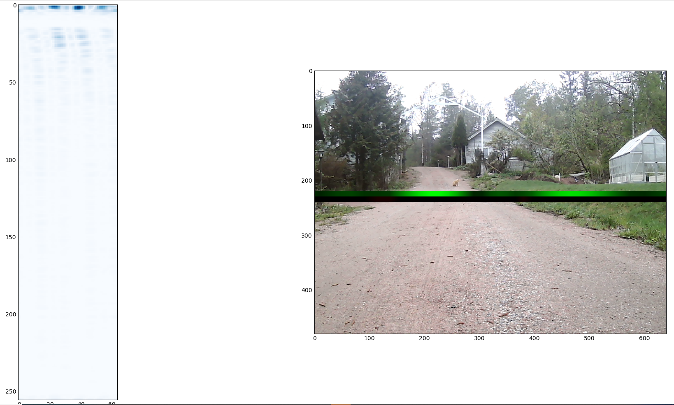
Outside no reflections
xScaleFactor = 300
thetaScaleFactor = 1.6
The detections are all from 0 range and those ones also cause multiple detections
At further ranges
In this picture the first 10 bins were not set to 0 unlike in the above ones

Slide 21
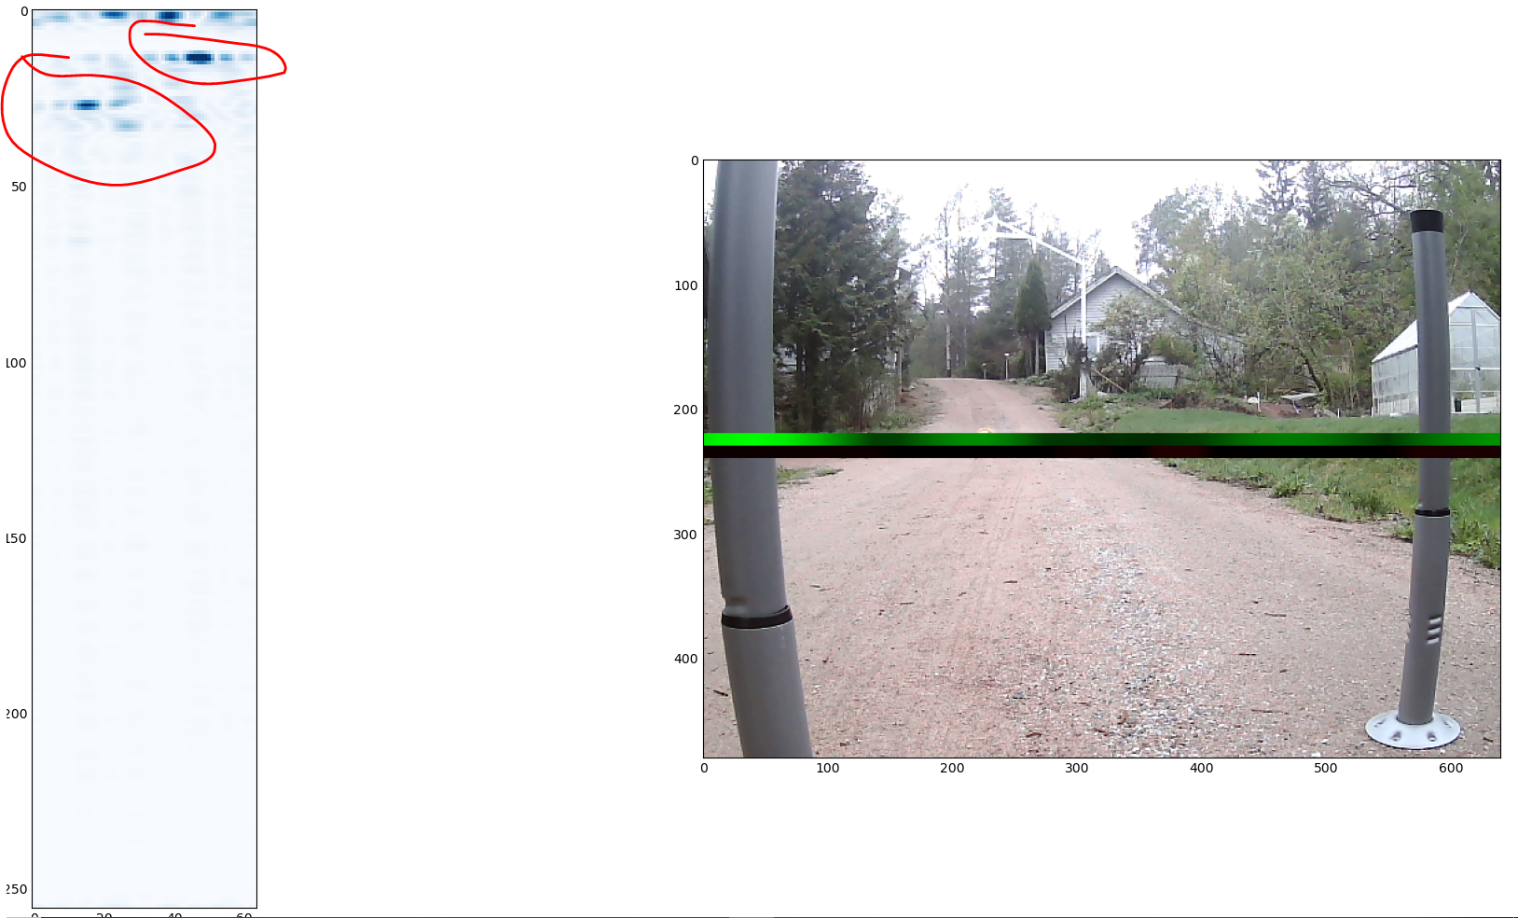
Outside
xScaleFactor = 300
thetaScaleFactor = 1.6
Hyvin käyttäytyviä heihastuksia. Pysyy yhdessä kasassa

Slide 22
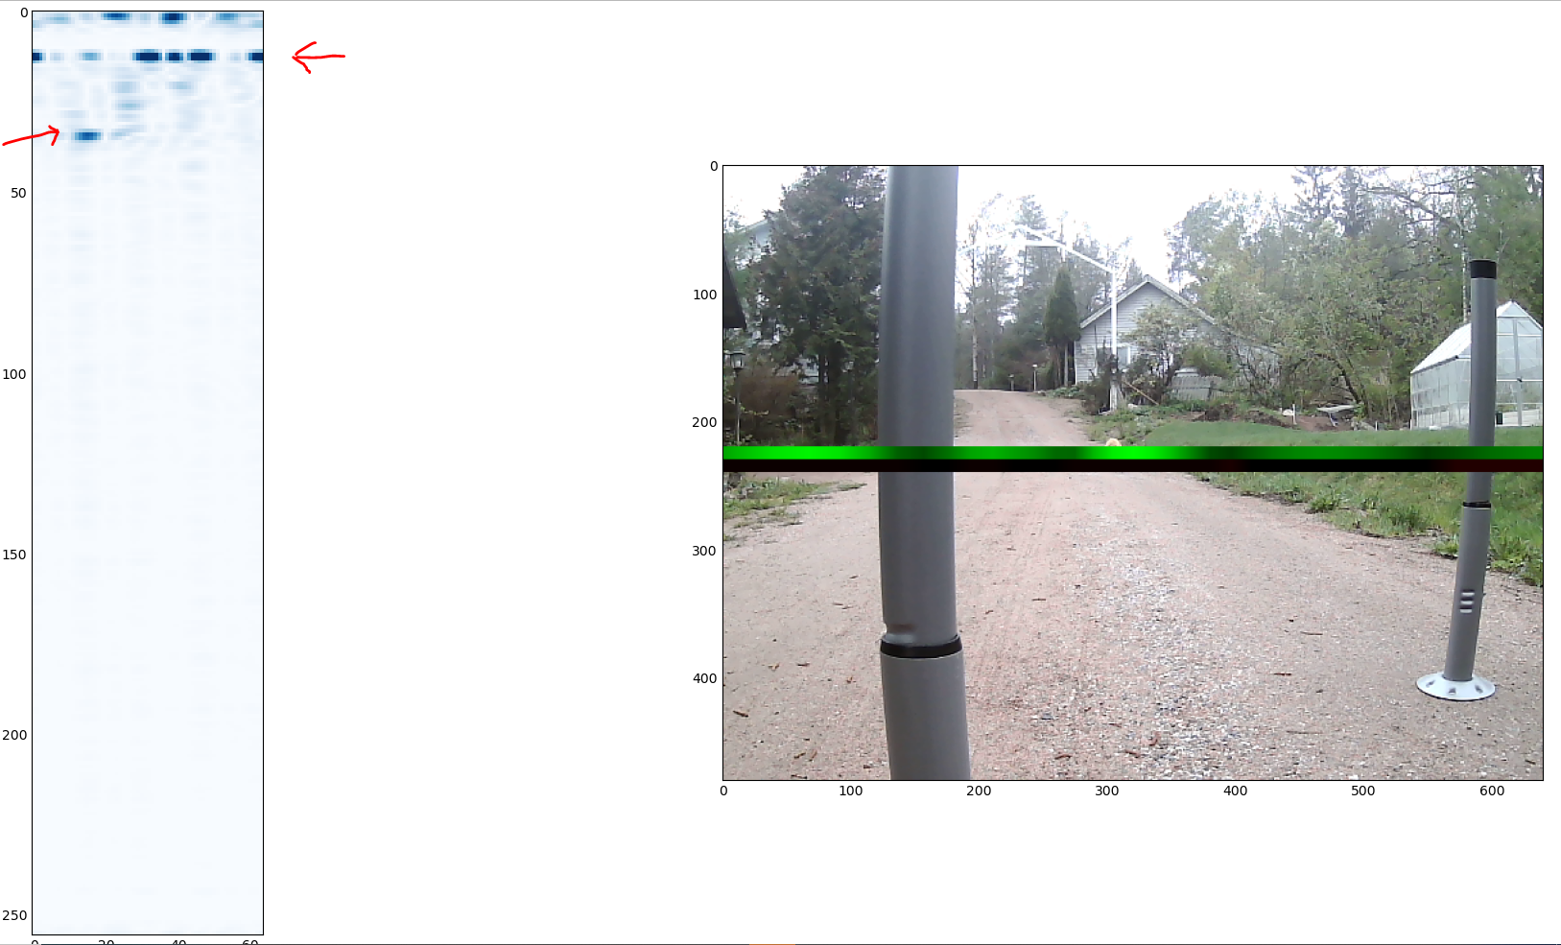
Detections breaking up into multiple parts
A singular object has made a total of 5 detectable peak values (closer metal pole)

Slide 23
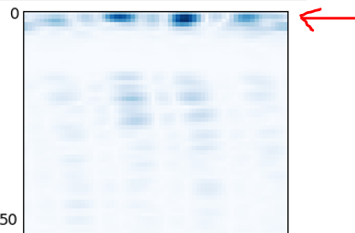
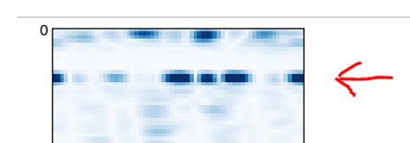
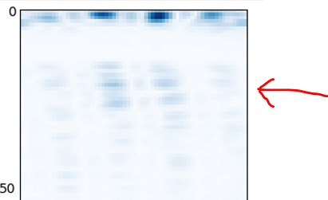
Identified major problems
1. About 4cm away from the sensor (first bins) the sensor has very hard reflection that should not be there
2. Objects may not get get recognised in all angle bins and their angular being might split into 5 different distinguishable angle bin clusters
3. A close by detection will make shadows of itself behind it.

Slide 24
Effects
If problem 1. is not solved then we can not use the MAXreflection(distance) to reduce the dimensions to 1D, as all the maximum values are in the first bins and will result in the detection being at 4cm

Slide 25
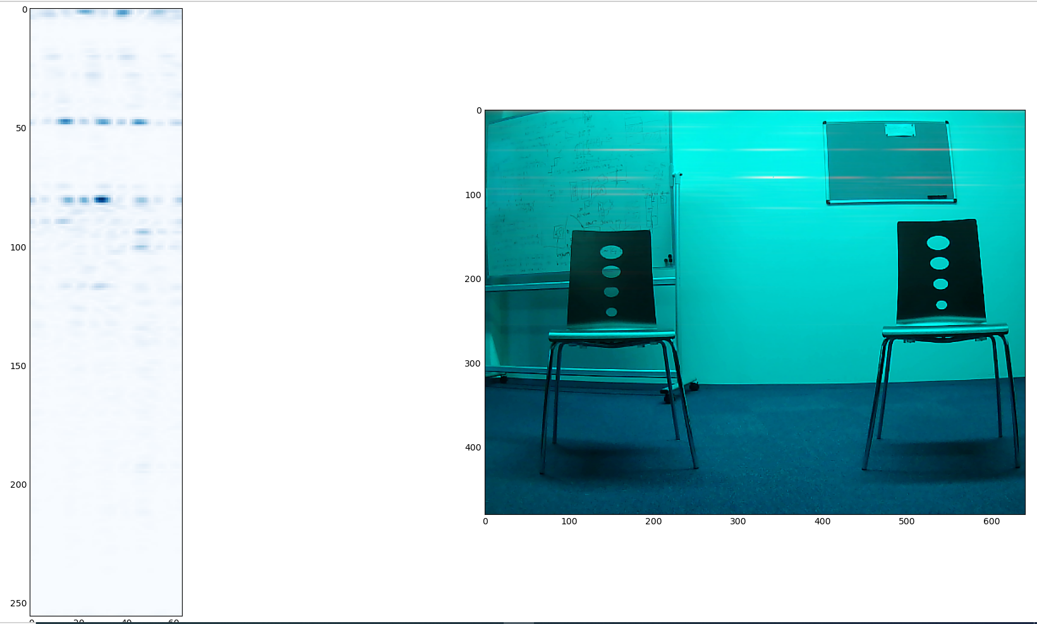
Whole depthmap imposed on image
Notice Left Right switch in polar when going to image

Slide 26
Problem 2:
The x axis (azimuth) is obtained from complex input FFT.
Complex input -> no mirror images present. The detection does not have unnecessary information, even though not cut at nyquist frequency.
Doesnt one object turning into peak, throph and lower peak look an awful lot like a sinc pulse?
Sinc after FFT means a square before FFT
The antenna data is not windowed, so in essence it is square windowed before the FFT
How about if we window before the FFT?
TI does not do this, should we?

Slide 27
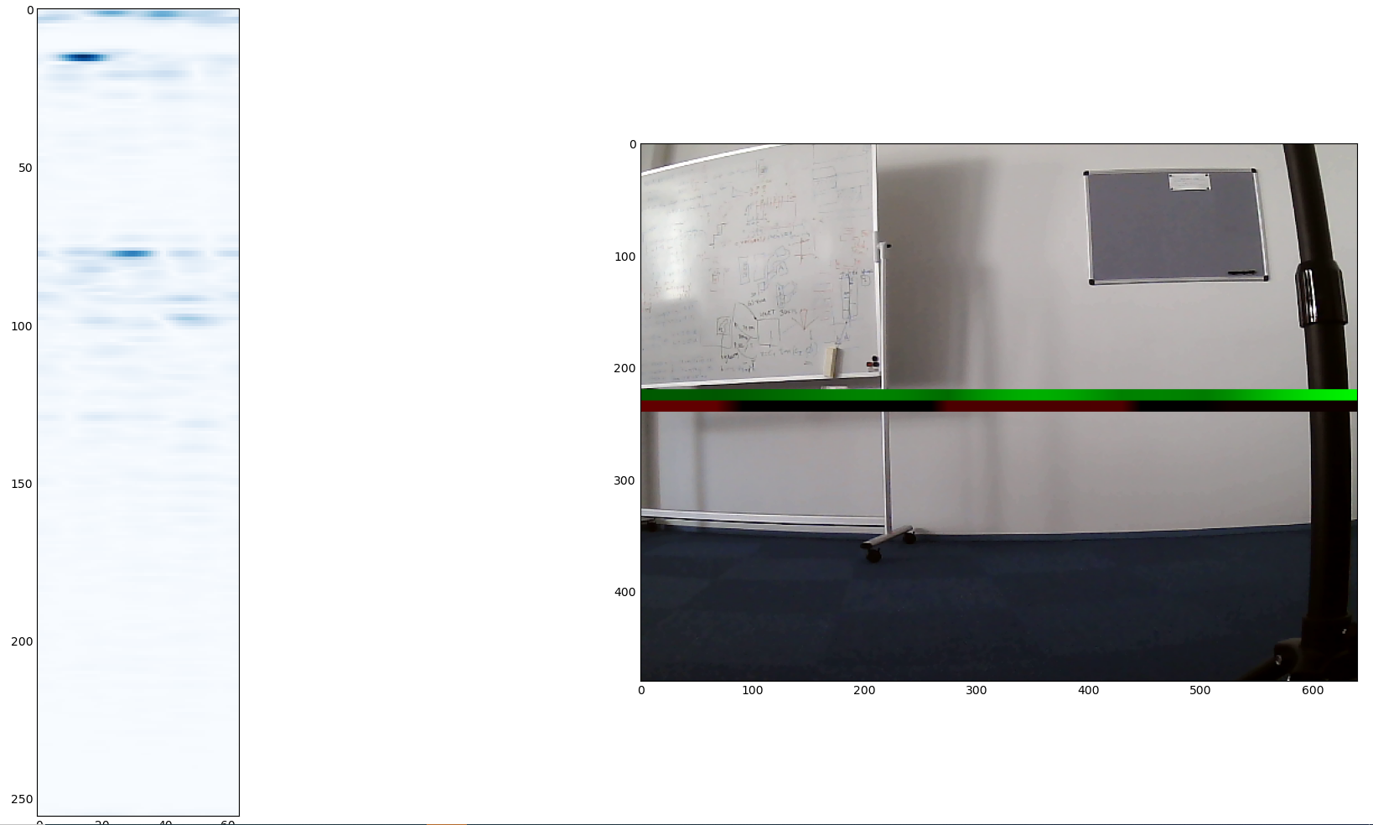
With blackman window
Compared to no window we lost angular resolution

Slide 28
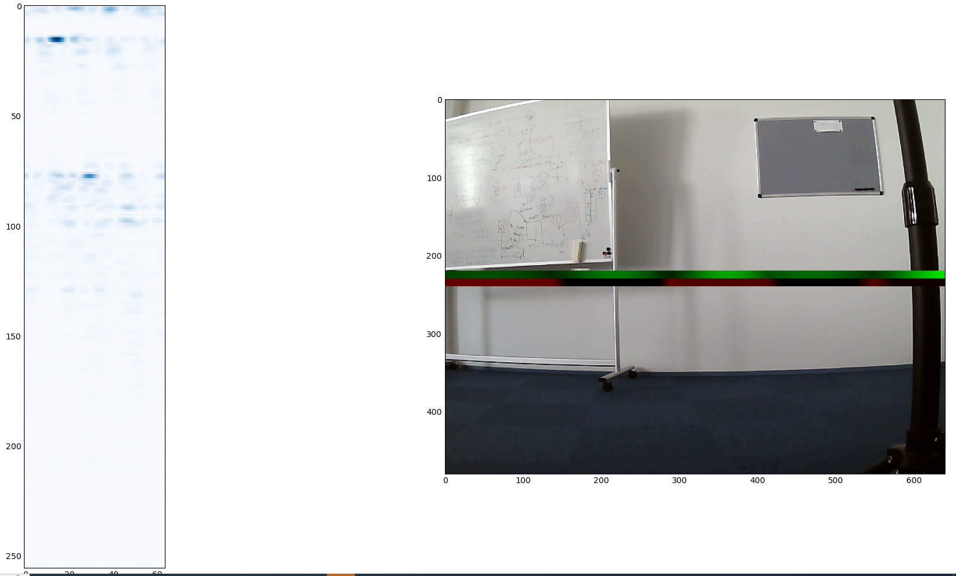
Without window
More angular resolution but ripples in the range bin

Slide 29
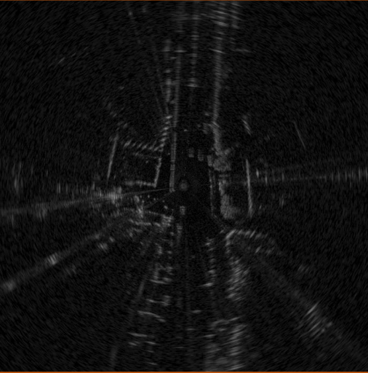
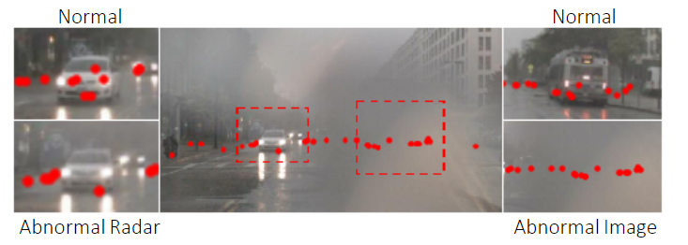
Dense vs Sparse, Whole image vs points

Slide 30
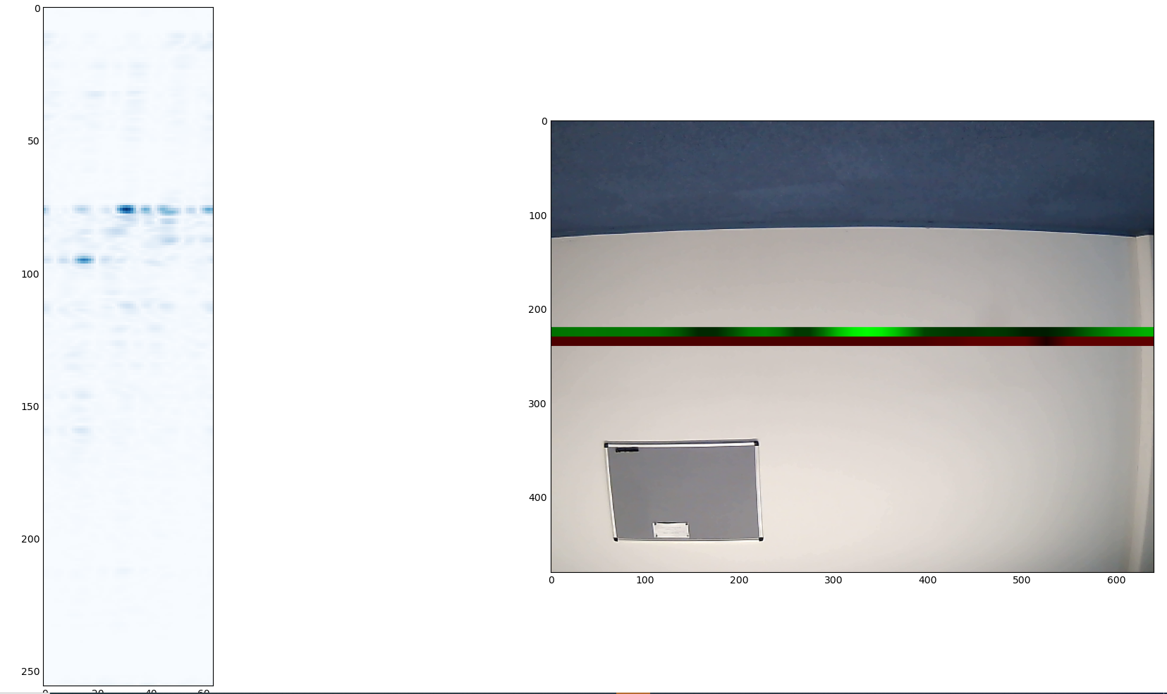
DC calibration
VS old

Slide 31
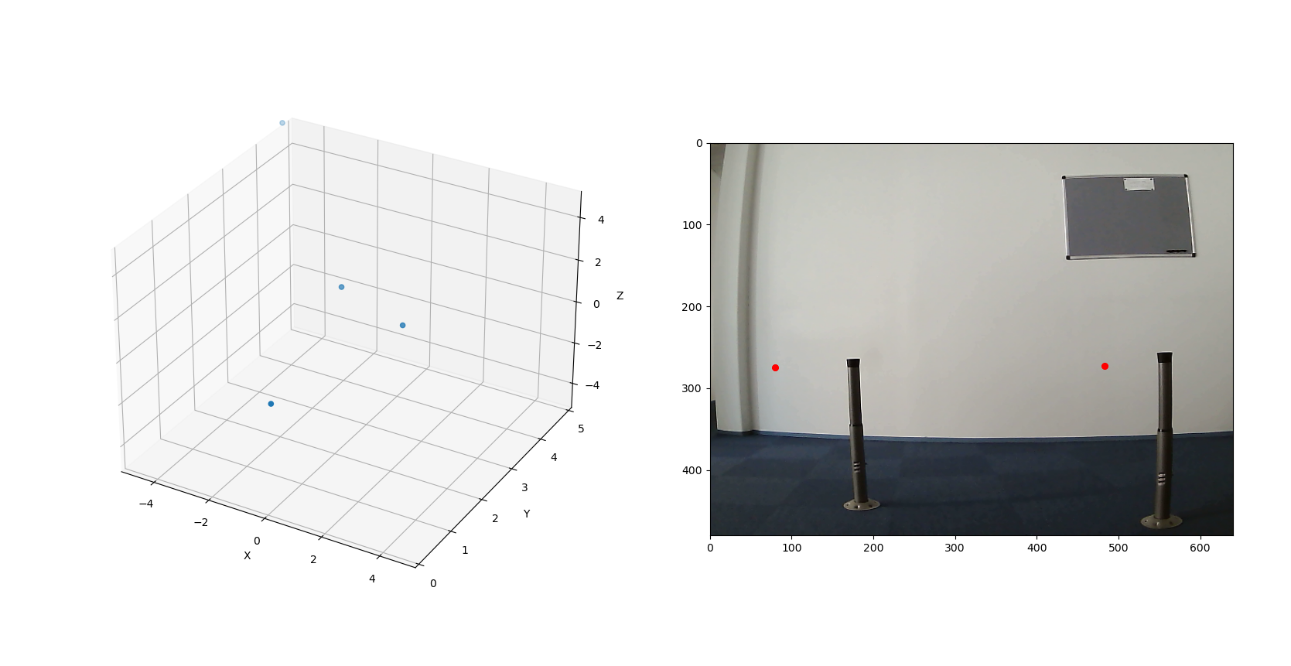
Pointcloud
Kaikki vähän vasemmalla jostain syystä. Ehkä huono kalibraatio.

